Slide 1
JavaFX GUI Components (1)
Presented by:
Michael Al Assaad Antonio Chedid Paul El Kouba

Slide 2
Overview
01
02
03
Getting Started
GUI
Components
DEMO

Slide 3
01
Getting Started
With JavaFX

Slide 4
DEFINITION OF CONCEPTS
Stage
Scene
Layout
VBox - HBox
The Stage is the window of the application.
The scene constitutes of the Frame.
Layout can be considered the panel.
A javafx.layout component that will be used in this presentation

Slide 5
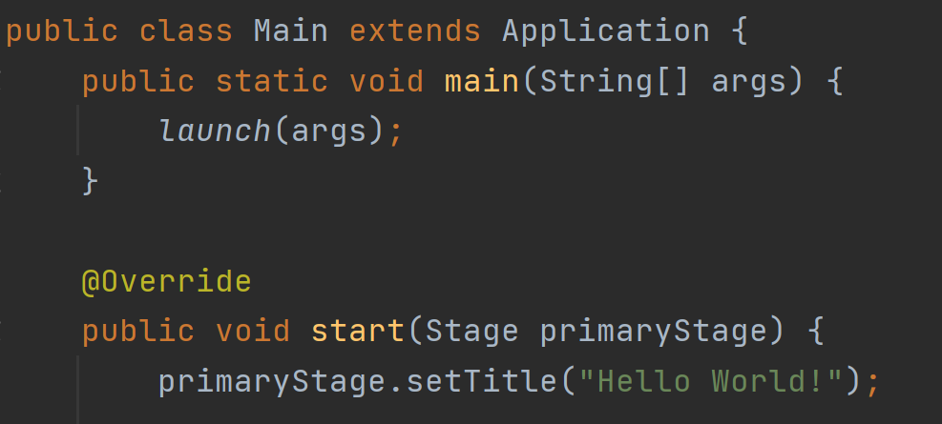
Layout
Scene
Stage

Slide 6

Layout
Scene
Stage

Slide 7
02
GUI Components

Slide 8
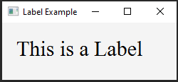
Labels
Labels are a simple output components used to print texts.
Label label = new Label();
Common Methods:
.setText(String s);
.setTextFill(Color.web("hex code"));
.setFont(Font.font("Font Name", Size));
.setRotate(int i);
.setTranslateY(int i);

Slide 9
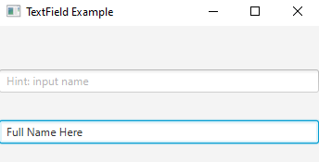
Text Fields
Text Fields are a input components where the user can input any String.
TextField textf = new TextField();
Common Methods:
.setPromptText(String s);
.getText();
.getText().isEmpty();
.setOnAction((ActionEvent e) -> { });

Slide 10
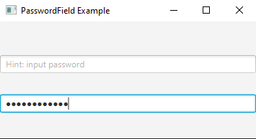
Password Fields
Password Fields are a input components where the user can input hidden set of characters, usually a password.
PasswordField passf = new PasswordField();
Common Methods:
.setPromptText("Hint");
.getText();
.setOnAction((ActionEvent e) -> { });

Slide 11
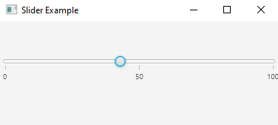
Sliders
Sliders are input components.
Slider slider = new Slider();
Common Methods:
.setMin(int i);
.setMax(int i);
.setValue(int i);
.setShowTickLabels(boolean b);
.setShowTickMarks(boolean b);
.setMajorTickUnit(int i);
.setMinorTickCount(int i);
.getValue();
.setSnapToTicks(boolean b);

Slide 12
Sliders
Common Methods:
.valueProperty().addListener(new ChangeListener<Number>() {
public void changed(ObservableValue<? extends Number> ov,
Number old_val, Number new_val) {
//Do Something For Every Change Detected
}});

Slide 13
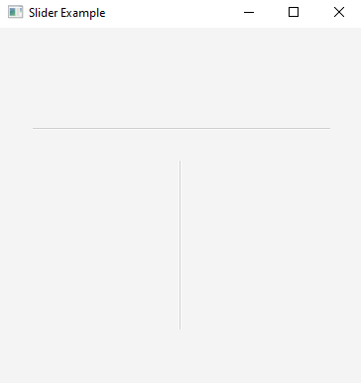
Separators
Separators are line generated to separate multiple components, to design the scene.
Separator separator = new Separator();
Common Methods:
.setMaxWidth(int i);
.setPrefHeight(int i);
.setHalignment(HPos p);
.setValignment(VPos p);
.setOrientation(Orientation z);

Slide 14
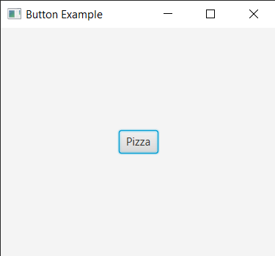
Buttons
Buttons are used for controlling the behavior of an application where an action will be triggered once it is clicked.
Button button = new Button ();
Common Methods:
.setOnAction(EventHandler <ActionEvent> actionEvent);
.setShape(Shape shape);
.setText(String str);
.setRotate(double v);
.setTranslateX(double x);
.setTranslateY(double y);

Slide 15
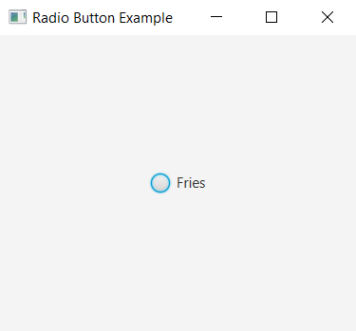
Radio Buttons
RadioButton is a button that can be selected or not selected.
RadioButton radioButton = new RadioButton ();
Common Methods:
.setOnAction(EventHandler <ActionEvent> actionEvent);
.isSelected();
.setText(String str);
.setToggleGroup(ToggleGroup tg);
.setTranslateX(double x);
.setTranslateY(double y);

Slide 16
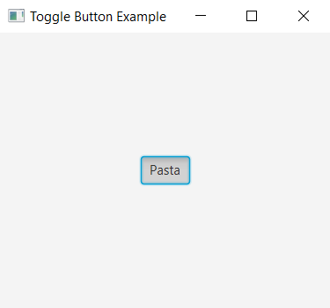
Toggle Buttons
A Toggle Button is like a button that stays in when you press it, and when you press it the next time it comes out again.
ToggleButton = new ToggleButton ();
Common Methods:
.setOnAction(EventHandler <ActionEvent> actionEvent);
.setShape(Shape shape);
.setText(String str);
.setToggleGroup(ToggleGroup tg);
.setTranslateX(double x);
.setTranslateY(double y);

Slide 17
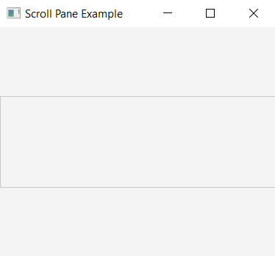
Scroll Pane
A scroll pane holds a UI element and provides a scrollable view of it.
ScrollPane scrollPane = new ScrollPane();
Common Methods:
scrollPane.setHbarPolicy(ScrollBarPolicy.NEVER);
scrollPane.setVbarPolicy(ScrollBarPolicy.ALWAYS);

Slide 18
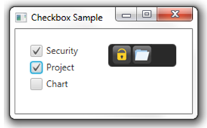
Checkbox
^{Similar to Radio Buttons.}
Can be toggled between 3 states: checked, unchecked, and indeterminate.
CheckBox cb = new CheckBox(String t);
Common Methods:
^{.setIndeterminate(boolean v);}
^{.setSelected(boolean v);}
^{.isSelected();}

Slide 19
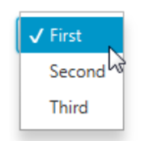
Choice Box
Shows a list of items (drop-down) specified by an observableList.
ChoiceBox cb = ChoiceBox(ObservableList items); OR
ChoiceBox cb = ChoiceBox();
Common Methods:
.getItems();
.getValue();
.hide();
.setItems(ObservableList value);
.show();

Slide 20
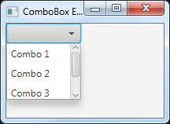
Combo Box
Similar to a Choicebox: shows several items in a drop down menu.
Useful when the number of items exceeds some limit because it can add scrolling to the drop-down list.
ComboBox cb = new ComboBox(ObservableList items); OR
ComboBox cb = new ComboBox();
Common Methods:
.getItems();
.getVisibleRowCount();
.setItems(ObservableList items);
.setVisibleRowCount(int v);

Slide 21
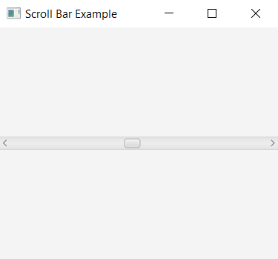
Scroll Bar
Enables Scrollable Panes in application.
ScrollBar sc = new ScrollBar();
Common Methods:
.setValue(int v);
.setMin(int v);
.setMax(int v);
.increment();
.decrement();
.setOrientation(Orientation value);
.setPrefWidth();

Slide 22
03
Restaurant DEMO

Slide 23
References
JavaFX Tutorial (tutorialspoint.com)
VBox (JavaFX 8) (oracle.com)
HBox (JavaFX 8) (oracle.com)
ScrollPane (JavaFX 8) (oracle.com)
ScrollBar (JavaFX 8) (oracle.com)
Label (JavaFX 8) (oracle.com)
TextField (JavaFX 8) (oracle.com)
PasswordField (JavaFX 8) (oracle.com)
Slider (JavaFX 8) (oracle.com)
Separator (JavaFX 8) (oracle.com)
Button (JavaFX 8) (oracle.com)
RadioButton (JavaFX 8) (oracle.com)
ToggleButton (JavaFX 8) (oracle.com)
CheckBox (JavaFX 8) (oracle.com)
ChoiceBox (JavaFX 8) (oracle.com)
ComboBox (JavaFX 8) (oracle.com)
JavaFX RadioButton (jenkov.com)
JavaFX | ChoiceBox - GeeksforGeeks
JavaFX | Checkbox - GeeksforGeeks
JavaFX | Checkbox - GeeksforGeeks
JavaFX ChoiceBox (jenkov.com)

